Slide 1
STATIONARY STORE MANAGEMENT

Slide 2
TEAM MEMBERS:
Harini sri 1934009
Preethi 1934029
Shamruthi 1934041
Tanuja 1934052
Varsha 1934055
👩
👩
👩
👩
👩

Slide 3
WHY STATIONARY STORE MANAGEMENT?
This mini project is designed for stores
that deals with stationaries.
It helps you to maintain the list of
stocks .You can add, update and
view the list of items in the store

Slide 4


LIBRARIES USED
TKINTER
MYSQL.CONNECTOR/PYMYSQL

Slide 5
MYSQL
DATABASE – STORE
TABLE(S)-STATIONARY
ATTRIBUTES- item_name, item_price , item_quantity , item_category , item_discount, item_id.
PROCEDURE(DELETE)

Slide 6
TABLE
ATTRIBUTES:
item_name -VARCHAR
item_price –INTEGER
item_quantity - INTEGER
item_category -VARCHAR
item_discount -FLOAT
item_id –INTEGER(AUTO INCREMENT)

Slide 7
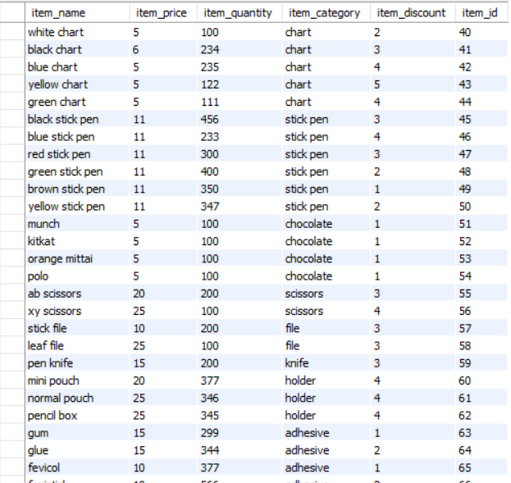
STATIONARY TABLE IN MYSQL

Slide 8
PROCEDURE(DELETE) IN MYSQL
QUERY:
create procedure dele_item() delete from stationary where stationary.item_name = item_name;

Slide 9
HOME PAGE
SAMPLE SNIPPET:
label0 = Label(root, text="STATIONERY STORE MANAGEMENT SYSTEM ", bg="Black", fg="#F9FAE9", font=("Times", 27), width=39)
label1 = Label(root, text="ENTER ITEM NAME", bg="black", relief="ridge", fg="white", bd=8, font=("Times", 12), width=25)
entry1 = Entry(root, font=("Times", 14), bd=8, width=25, bg="white")
buttoncolor = "#49D810"
buttonfg = "black"
button1 = Button(root, activebackground="green", text="ADD ITEM", bd=8, bg=buttoncolor, fg=buttonfg, width=25, font=("Times", 12), command=additem)

Slide 10
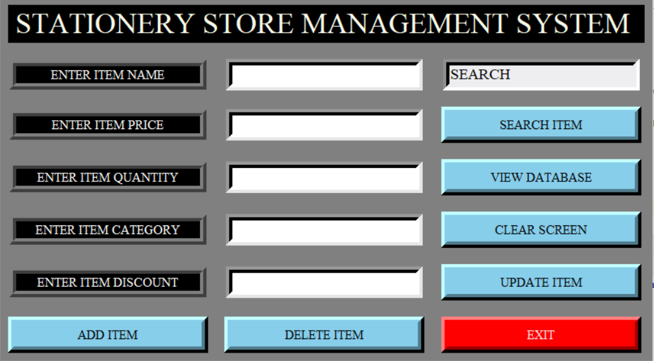
HOME PAGE

Slide 11
VIEW DATABASE
SAMPLE SNIPPET:
root1 = Tk()
root1.configure(bg="Grey")
root1.title("Stationary Store Database")
my_cursor.execute("select * from stationary")
mytext1 = my_cursor.fetchall()
mytext = Text(root1, width=90, height=20, bg="gray", fg="black", font=("Times", 12))
mytext.insert(END, " Item_Name \t\tItem_Price \t\tItem_Quantity \t\tItem_Category \t\tItem_Discount \n")
mytext.insert(END, " ------------ \t\t----------- \t\t-------------- \t\t--------------- \t\t--------------- \n")
for row in mytext1:
mytext.insert(END,
" {0} \t\t {1} \t\t {2} \t\t {3} \t\t {4}\n".format(row[0], row[1], row[2], row[3], row[4]))
mytext.pack(side=LEFT)

Slide 12
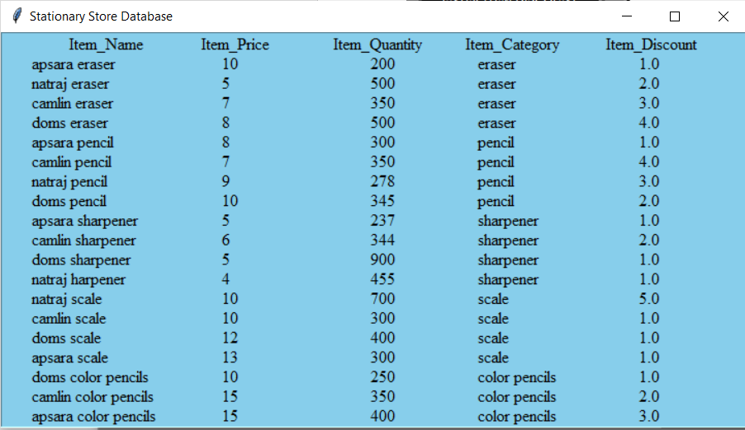
VIEW DATABASE

Slide 13
ADD ITEM(INSERTION)
SAMPLE SNIPPET:
e1 = entry1.get()
e2 = entry2.get()
e3 = entry3.get()
e4 = entry4.get()
e5 = entry5.get()
sql = "INSERT INTO stationary (item_name, item_price, item_quantity, item_category, item_discount) VALUES (%s,
%s, %s, %s, %s)"
val = (str(e1), e2, e3, str(e4), e5)
my_cursor.execute(sql, val)
mydb.commit()

Slide 14
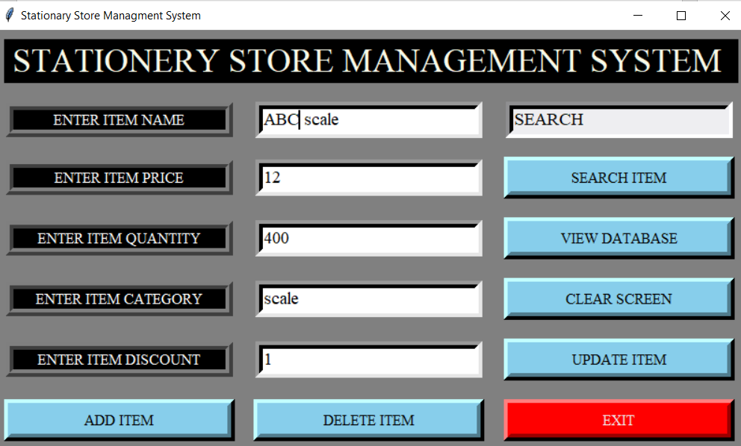
ADD ITEM

Slide 15
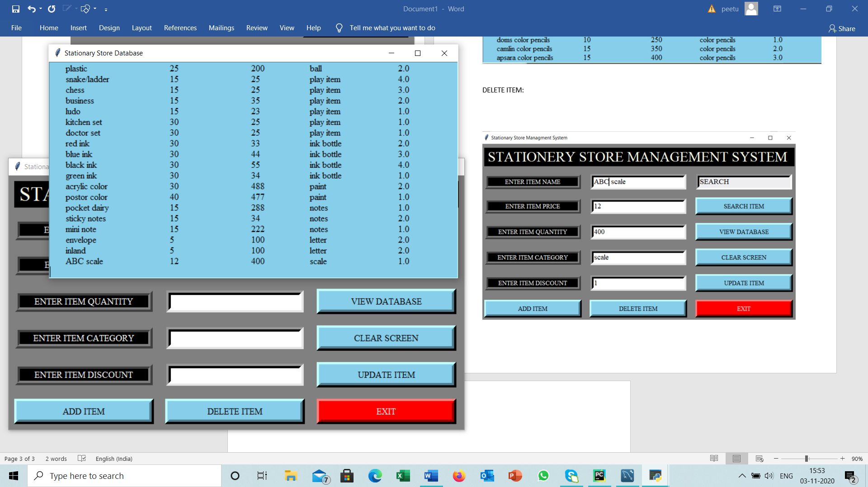
ADD ITEM
ABC SCALE IS INSERTED
👉

Slide 16
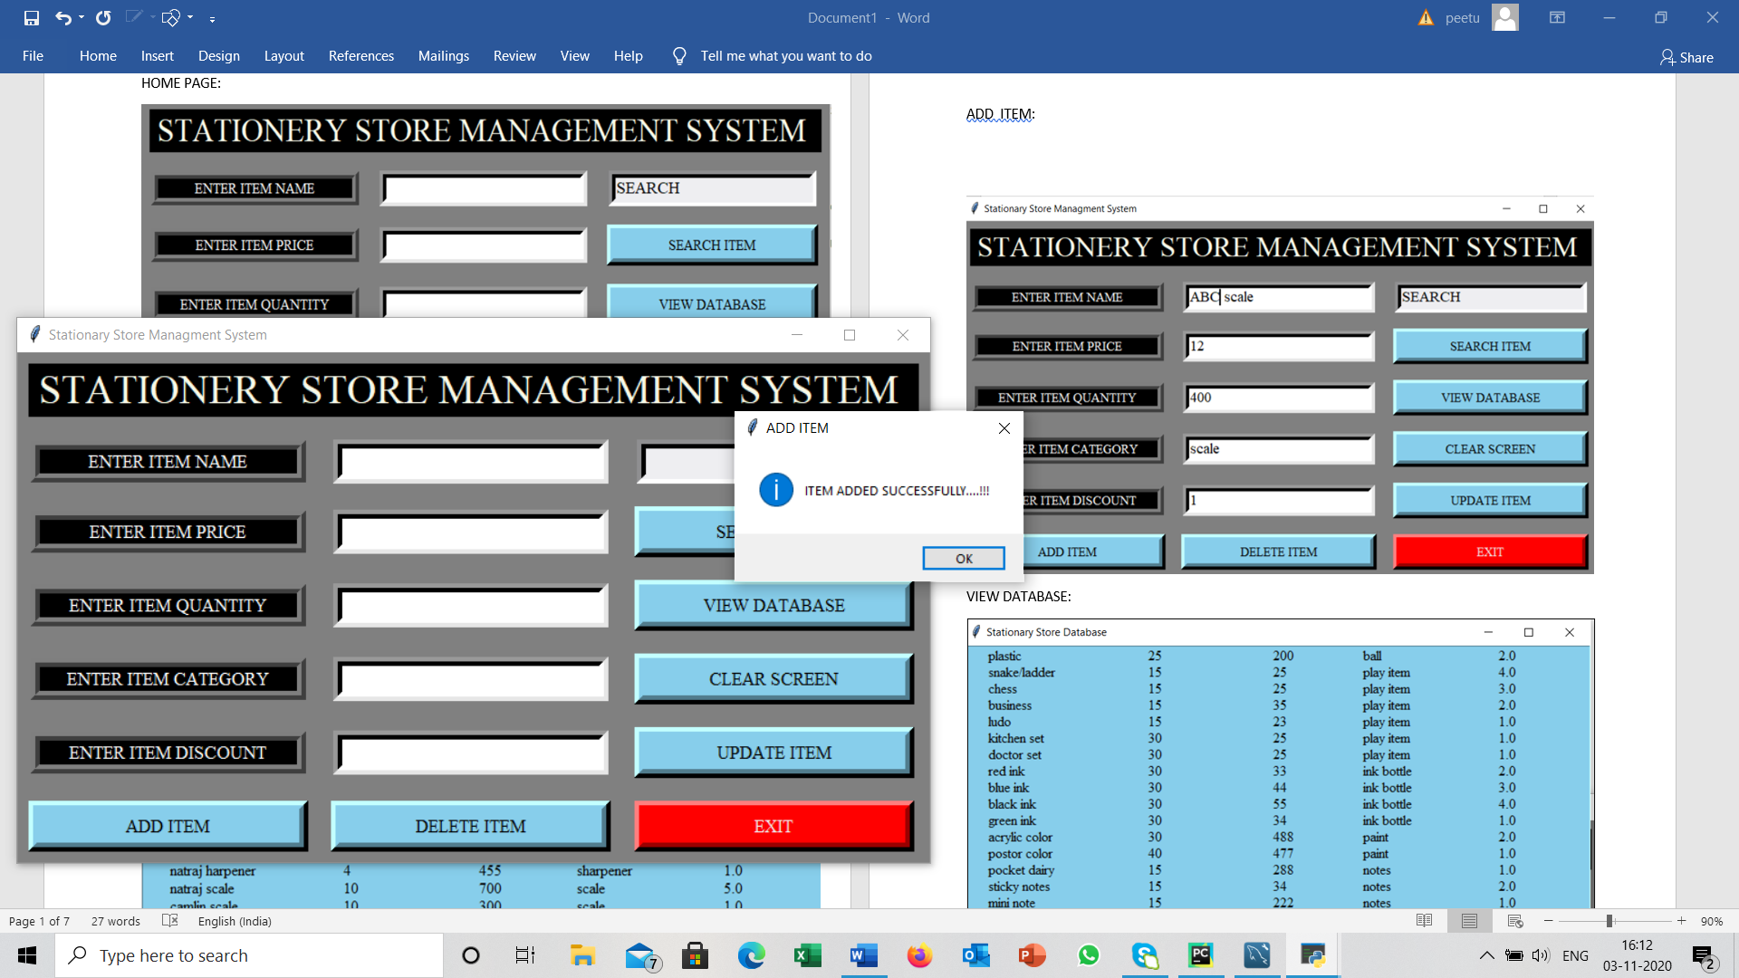
ADD ITEM
MESSAGE BOX POPS UP AFTER INSERTION.
messagebox.showinfo("ADD ITEM", "ITEM ADDED SUCCESSFULLY....!!!")

Slide 17
SEARCH ITEM
SAMPLE SNIPPET:
e6 = entry6.get()
if e6 == "SEARCH" or e6 == "": {
messagebox.showwarning("Warning", "Please first enter item name for search")
}
my_cursor.execute("select * from stationary where item_name = '{0}'".format(str(e6)))
mytext1 = my_cursor.fetchone()
if mytext1 == None:
messagebox.showinfo("Error", "Element not exist")
else:
entry1.insert(0, mytext1[0])
entry2.insert(0, mytext1[1])

Slide 18
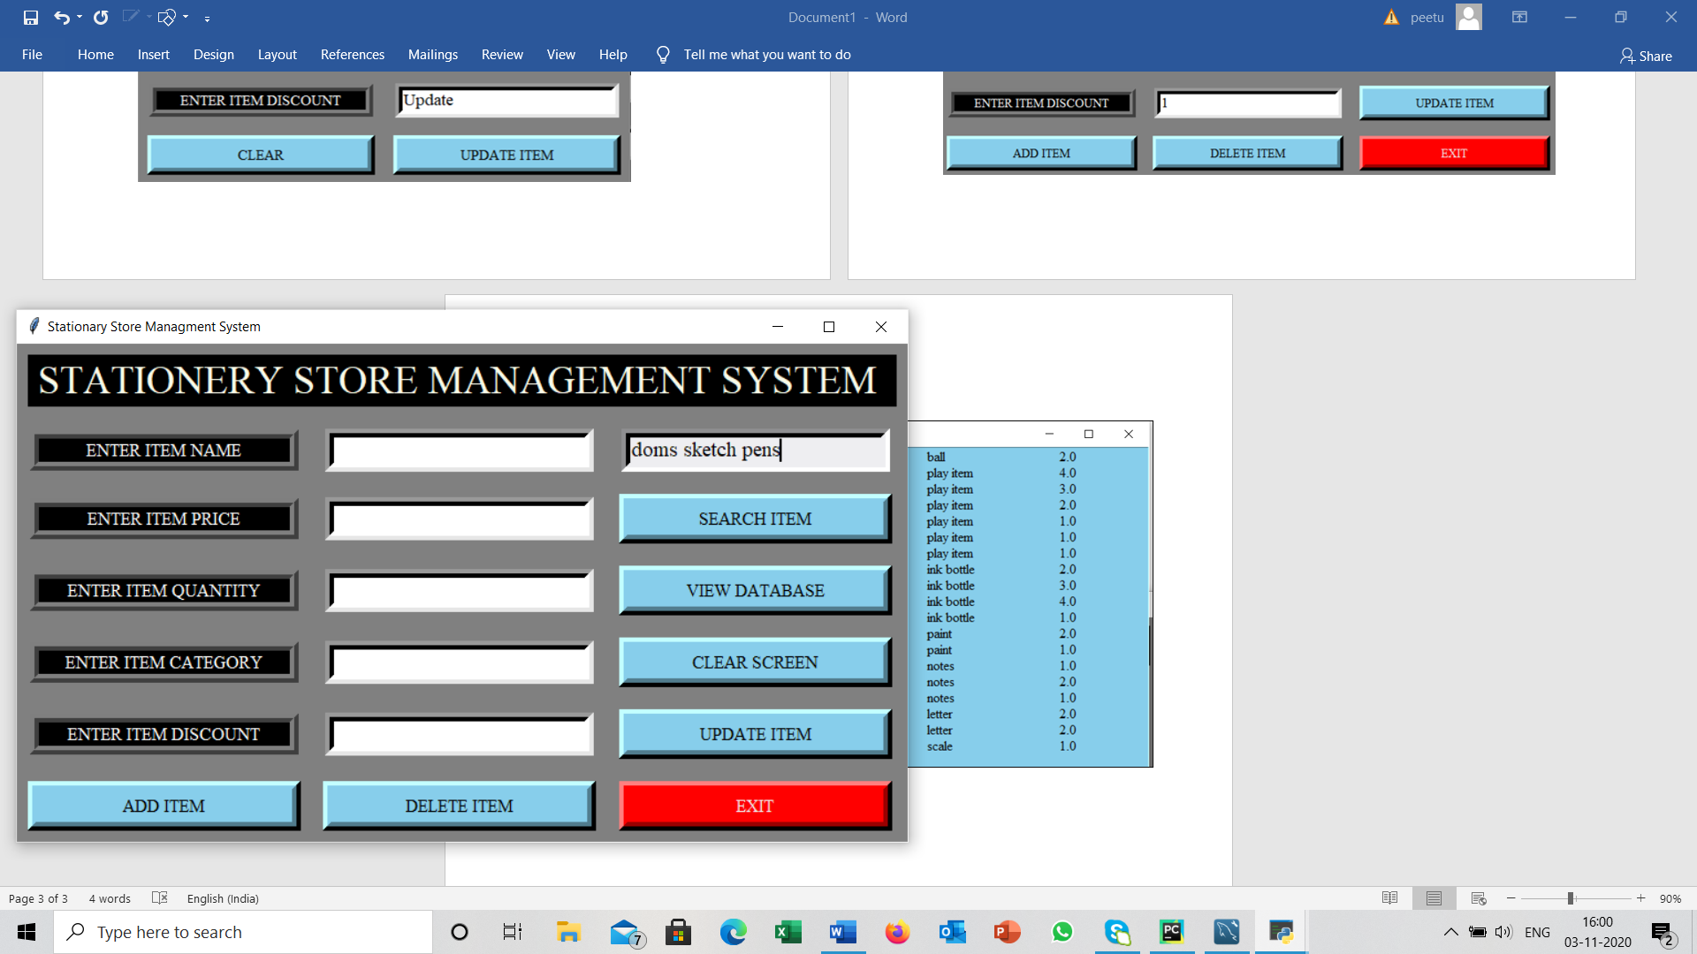
SEARCH ITEM
👉
SEARCH THE ITEM HERE

Slide 19
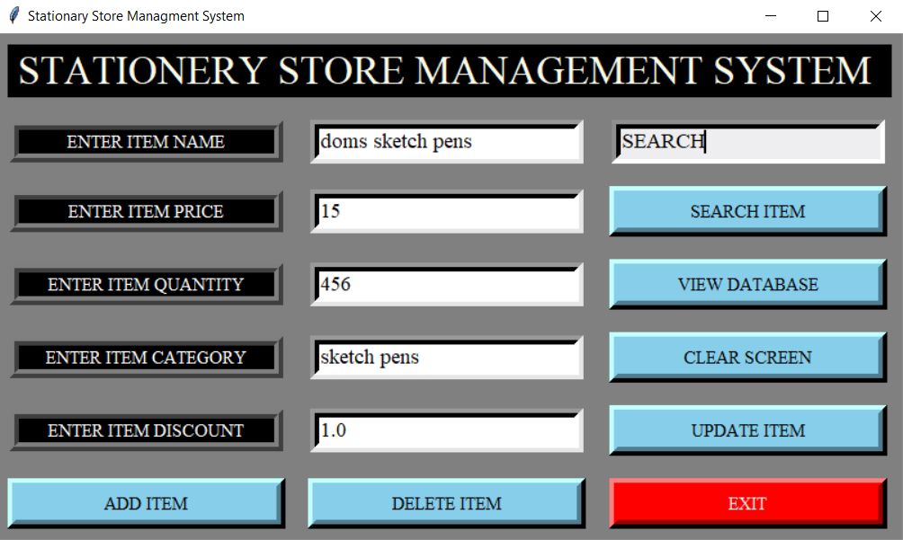
SEARCH ITEM
THE DETAILS OF THE SEARCHED
ITEM ARE DISPLAYED

Slide 20
CLEAR SCREEN
SAMPLE SNIPPET:
entry1.delete(0, END)
entry2.delete(0, END)
entry3.delete(0, END)
entry4.delete(0, END)
entry5.delete(0, END)

Slide 21
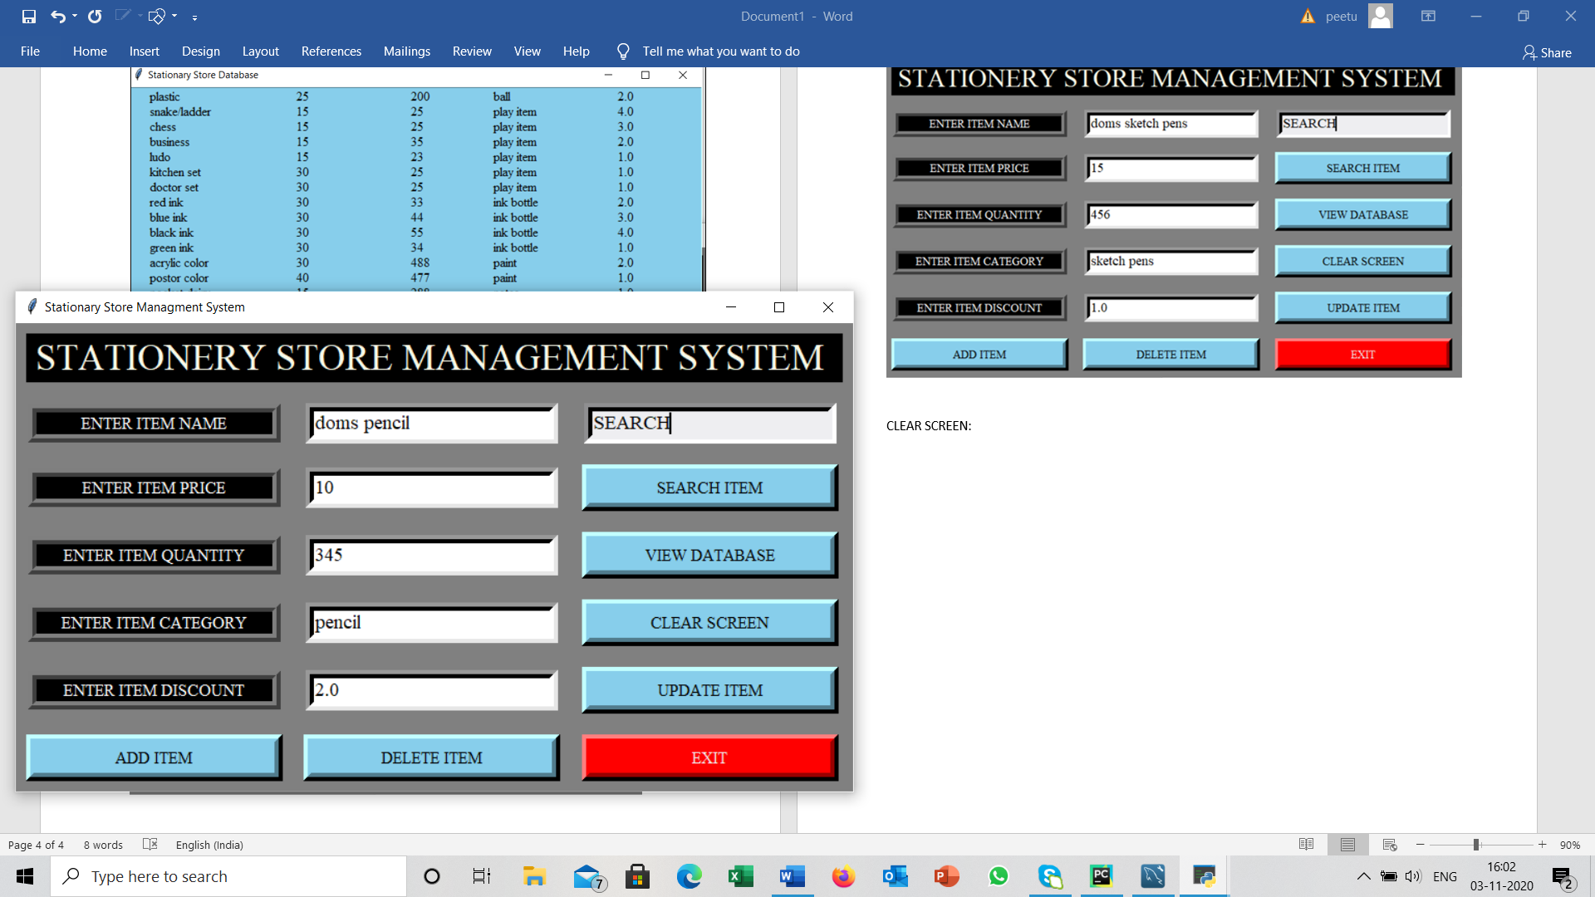
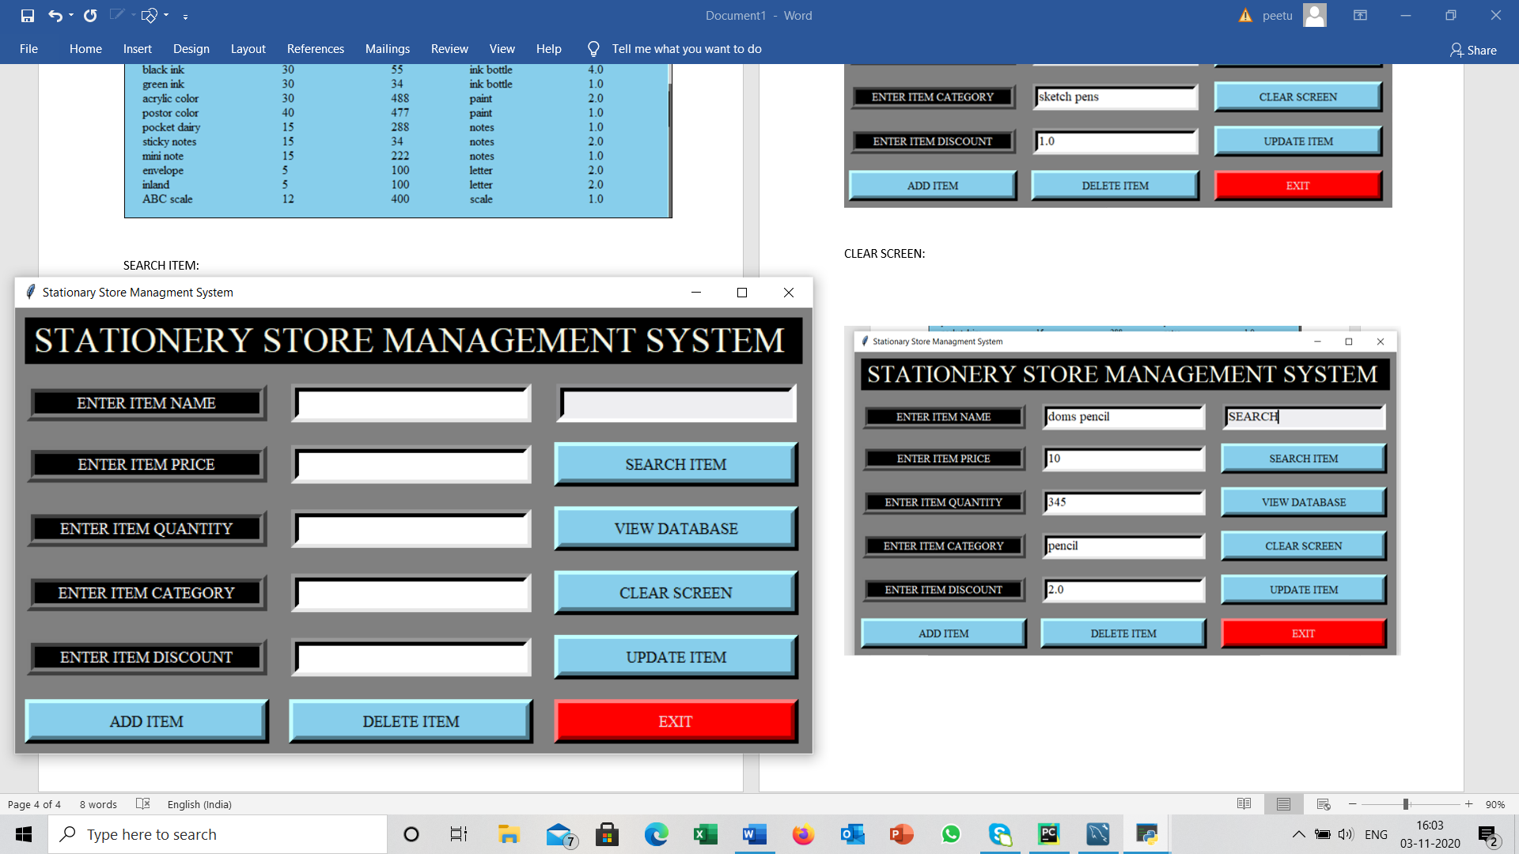
CLEAR SELECTION WILL CLEAR THE ENTERED DETAILS

Slide 22
UPDATE RECORD
A NEW WINDOW IS USED TO OBTAIN THE DETAILS OF THE ITEM TO UPDATED.
CODE SNIPPET:
ulabel1 = Label(root2, text="ENTER ITEM NAME", bg="black", relief="ridge", fg="white", bd=8, font=("Times", 12),width=25)
uentry1 = Entry(root2, font=("Times", 14), bd=8, width=25, bg="white")
ulabel1.grid(row=2, column=0, padx=10, pady=10)
uentry1.insert(0, "Update")

Slide 23
UPDATE RECORD
SAMPLE SNIPPET:
sql = "update stationary set item_name = %s, item_price = %s, item_quantity = %s, item_category = %s, item_discount = %s where item_name = %s"
val = (str(iname), iprice, iquantity, str(icategory), idiscount, str(e6))
my_cursor.execute(sql, val)
mydb.commit()

Slide 24
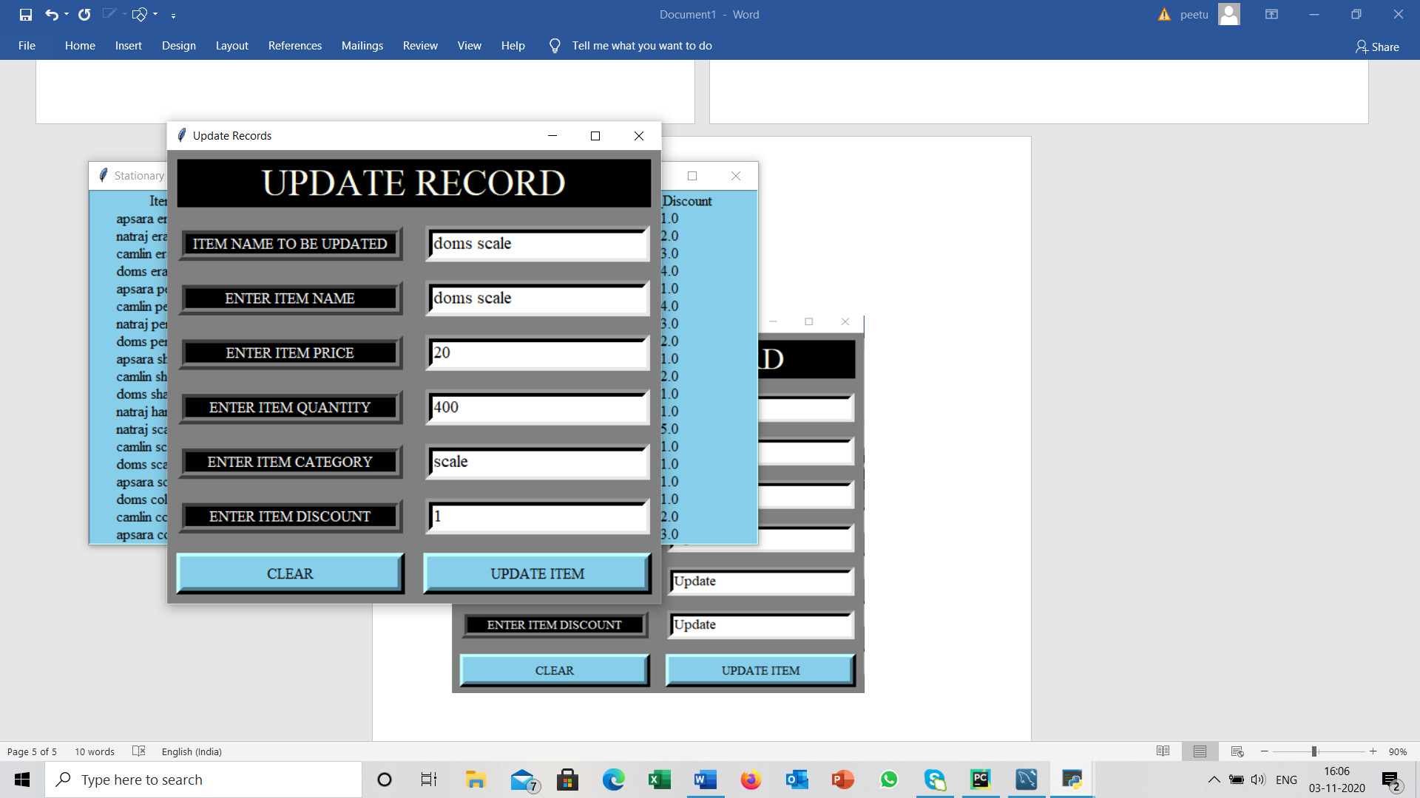
UPDATE RECORD
UPDATING THE PRICE OF
DOMS SCALE
👉

Slide 25
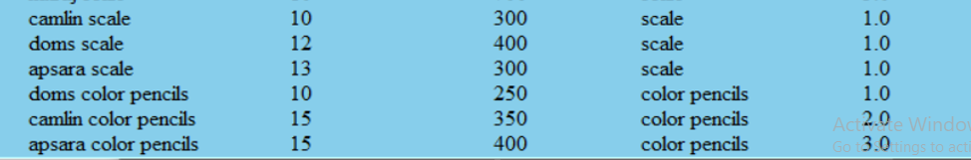
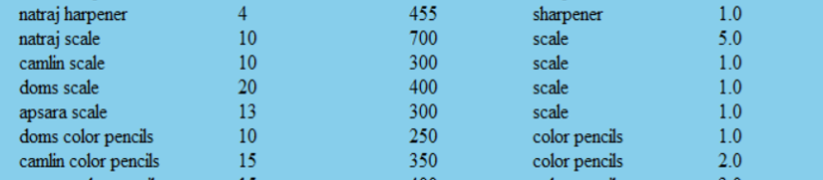
UPDATE RECORD
👉
👉

Slide 26
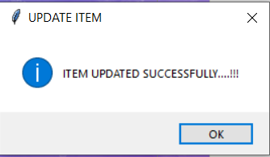
UPDATE RECORD
MESSAGE POPS UP AFTER THE ITEM IS UPDATED.
messagebox.showinfo("UPDATE ITEM", "ITEM UPDATED SUCCESSFULLY....!!!")

Slide 27
DELETE RECORD
SAMPLE SNIPPET:
e6 = entry6.get()
my_cursor.callproc('dele_item')
for result in my_cursor.stored_results():
print(result.fetchall())
mydb.commit()

Slide 28
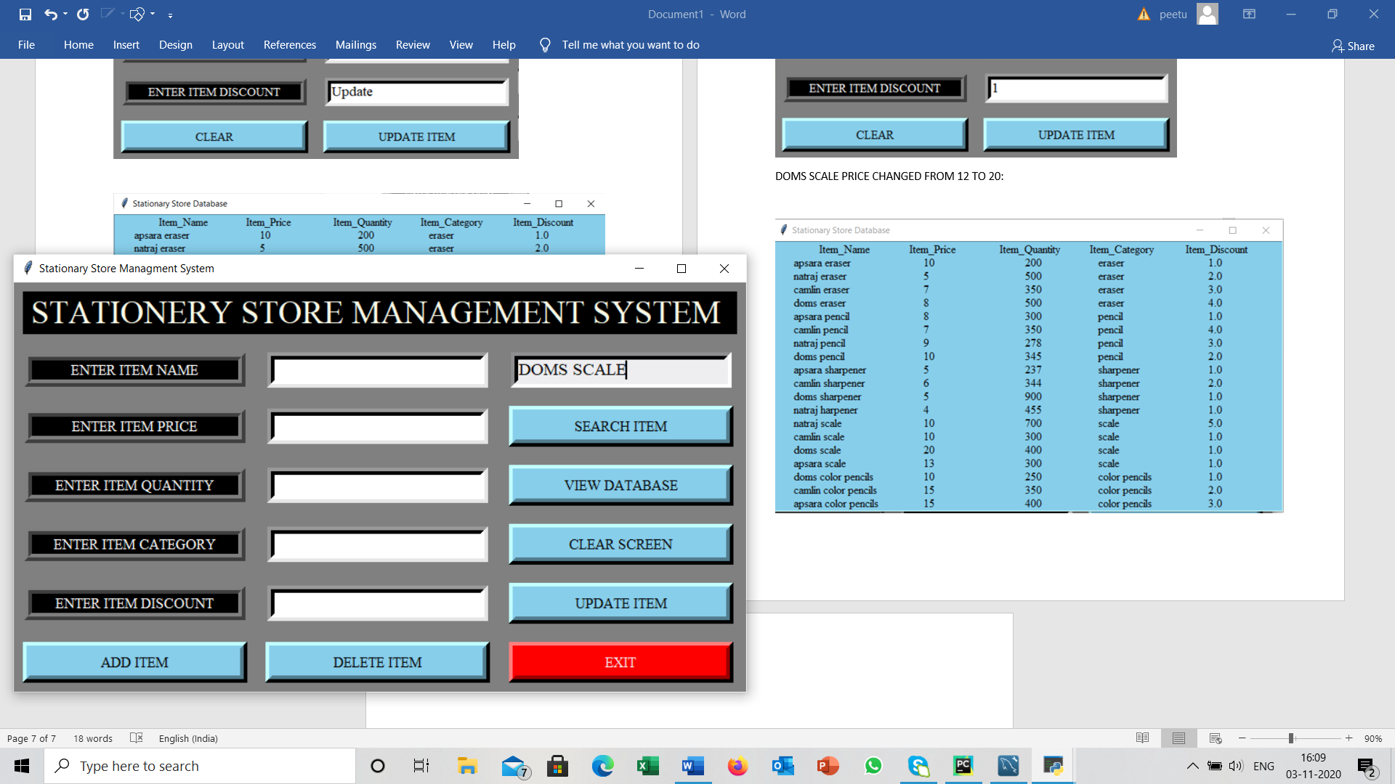
DELETE RECORD
👉
ENTER THE ITEM TO BE DELETED

Slide 29
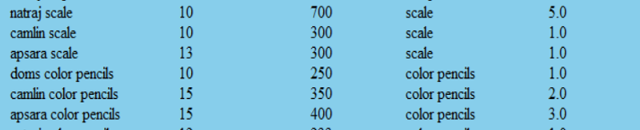
DELETE RECORD
I
ITEM IS DELETED FROM THE DATABASE

Slide 30
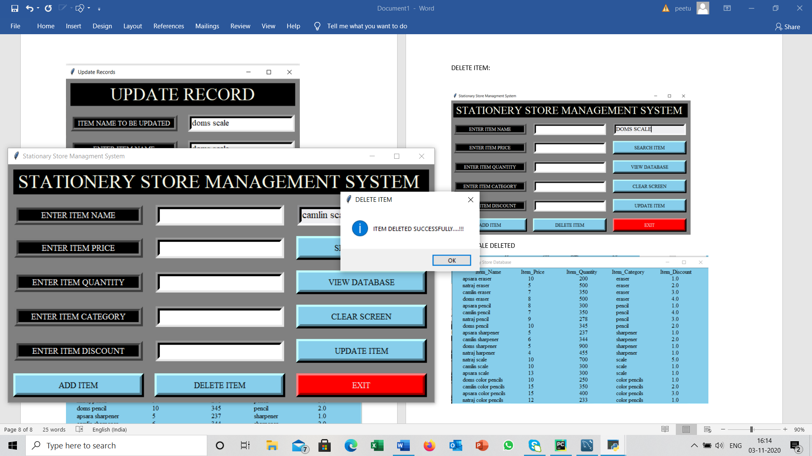
DELETE RECORD
MESSAGE BOX POPS UP AFTER DELETING THE ITEM.
messagebox.showinfo("DELETE ITEM", "ITEM DELETED SUCCESSFULLY....!!!")

Slide 31
EXIT
SAMPLE SNIPPET:
qExit = messagebox.askyesno("Quit System", "Do you want to quit? ")
if qExit > 0:
root.destroy()
return

Slide 32
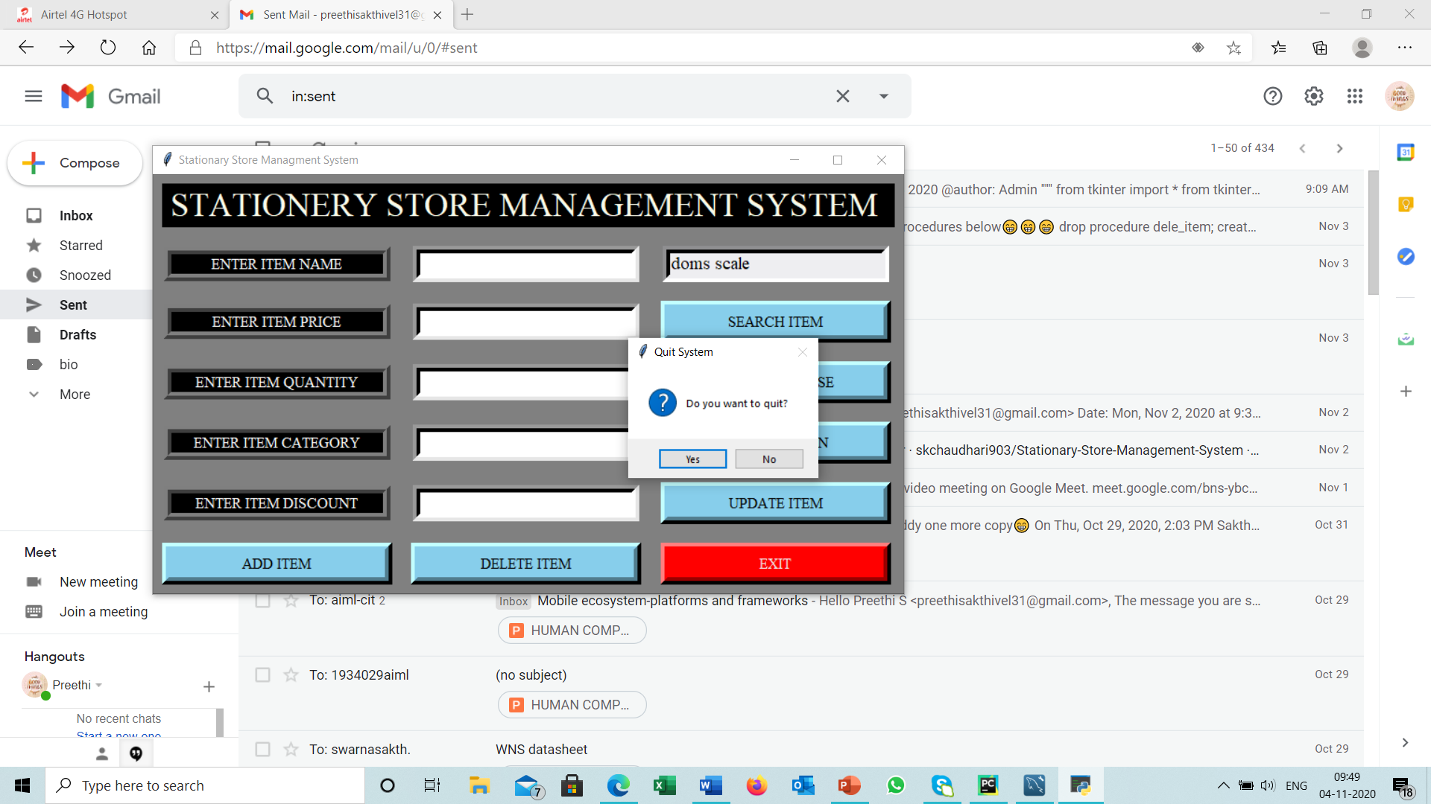
EXIT
IF YES ,THE PROCESS WILL TERMINATE.
IF NO,THEN YOU CAN CONTINUE THE ACTIONS.

Slide 33
CRITERIA’S DONE
1-TABLE (STATIONARY) WITH DEFAULT VALUES,PRIMARY KEY .
2-DB OPERATION-INSERTION,DELETION,SELECTION AND UPDATION.
3-CURSORS
4-GUI-TKINTER
5-PROCEDURE(DELETION),ADDITIONAL FEATURE-CLEAR

Slide 34
THANK YOU!

